Slide 1
Image
Image Element | Image Size| Image Formats
Notes:
Welcome to our lecture on HTML Image element. In this lecture we will go through the image element and its attributes, how to adjust image size, and finally different formats of the images like jpeg, png et cetra. Let’s start today’s lecture.

Slide 2
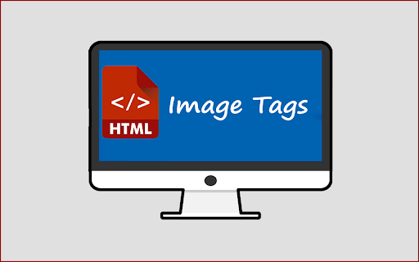
<img> Image
The <img> element is a void element used to display images on a webpage.
The <src> attribute specifies the URL of the image file to load.
Notes:
The image element is a void element in HTML used to display images on a webpage. It does not require a closing tag. To load an image, the source SRC attribute is used to specify the URL or file path of the image. This makes it possible to include and display visuals like pictures, logos, or graphics directly on the webpage, improving the overall user experience and content presentation.

Slide 3
<img> Image
The <alt> attribute provides a text description as an alternative if the image cannot load.
Example: <img src="https://example.com/family.jpg" alt="Smith family reunion"> displays an image or the alt text.
Notes:
The alternative attribute ALT in the image element provides a text description that appears if the image cannot load. This ensures accessibility and improves user experience. For example, using SRC equals to https example dot com slash family dot JPG alt equals Smith family reunion displays the image if available or shows the text description Smith family reunion when the image is unavailable.

Slide 4
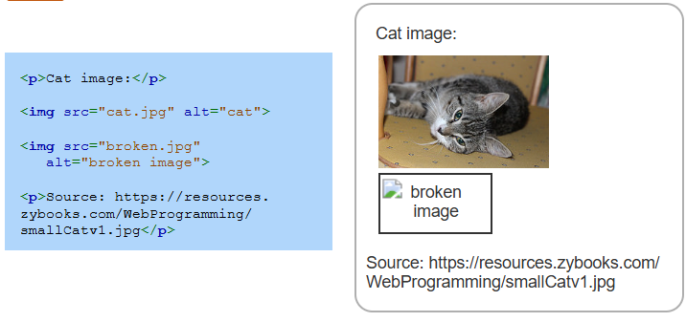
Example
Notes:
This example demonstrates the use of the image element with the s r c and alt attributes. The first IMG tag displays a cat image using SRC equals cat dot JPG and alt equals cat. The second IMG tag attempts to display a broken image using SRC equals broken dot JPG and alt equals broken image. If the image fails to load, the alt text, broken image, is displayed as a fallback.

Slide 5
Image Size
The width and height attributes of the img element define the image's size in pixels and are optional.
An image's aspect ratio is the ratio of its width to height, maintaining proportionality if only one dimension is specified.
Specifying both width and height values different from the image's aspect ratio may distort the image.
Notes:
Now let’s discuss how to adjust image size. The width and height attributes of the image element define the size of an image in pixels and are optional. An image's aspect ratio represents the relationship between its width and height, keeping proportionality if only one dimension is specified. However, specifying both width and height values that differ from the aspect ratio can distort the image. The example is shown below.

Slide 6
Image Formats
Web browsers support three popular image formats:
JPEG: Used for digital photographs.
PNG: Ideal for line art, screenshots, and transparent images.
GIF: Common for simple animated images.
Notes:
Now move on to image formats. Web browsers support three main image formats. JPEG is commonly used for digital photographs due to its efficient compression. PNG is ideal for line art, screenshots, and images requiring transparency. GIF is often used for simple animations. Each format serves specific use cases based on image type and requirements.

Slide 7
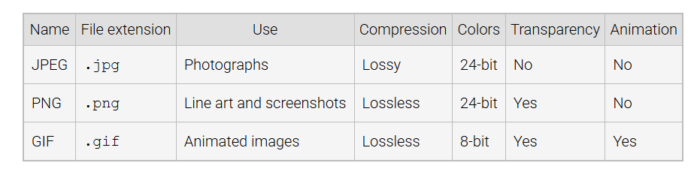
Three Popular Image Formats
Notes:
This table compares three popular image formats JPEG, PNG, and GIF. JPEG uses lossy compression, supports 24 bit colors, but does not allow transparency or animation. PNG uses lossless compression, supports 24 bit colors, and provides transparency but no animation. GIF uses lossless compression, supports 8 bit colors, and allows both transparency and simple animations. Each format serves different needs.

Slide 8
Other Image Formats
Less common image formats include:
APNG: Adds animation to PNG with true color support.
SVG: XML-based format for shapes and lines.
WebP: Supports true color, transparency, and animation.
AVIF: Supports transparency, high compression, and lossy/lossless options.
Notes:
Other than popular three formats, there some less common image formats. APNG enhances PNG with animation and true color support. SVG is an XML based format ideal for shapes and lines. Web P supports true color, transparency, and animation, while AVIF offers high compression, transparency, and both lossy and lossless options. These formats cater to specific use cases beyond the traditional ones.

